Slide 1
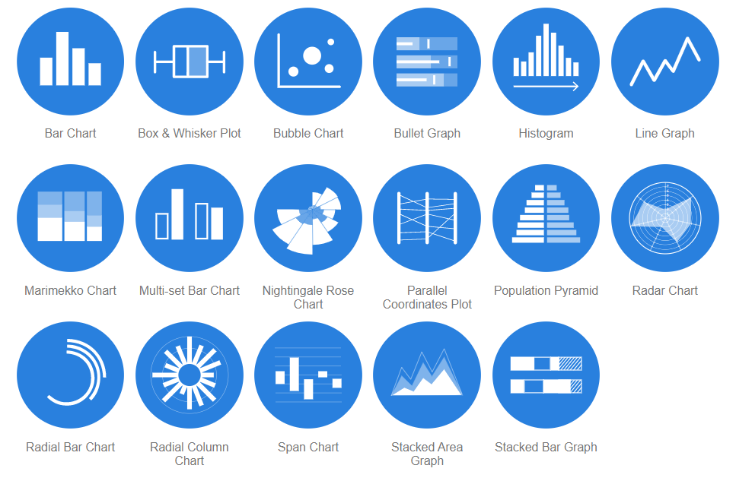
Data Visualization methods
https://datavizcatalogue.com/

Slide 2
Multidimensional data
http://projector.tensorflow.org/
Visualize a 200 dimensional data

Slide 3

https://teachablemachine.withgoogle.com/
Click on Get started

Slide 4
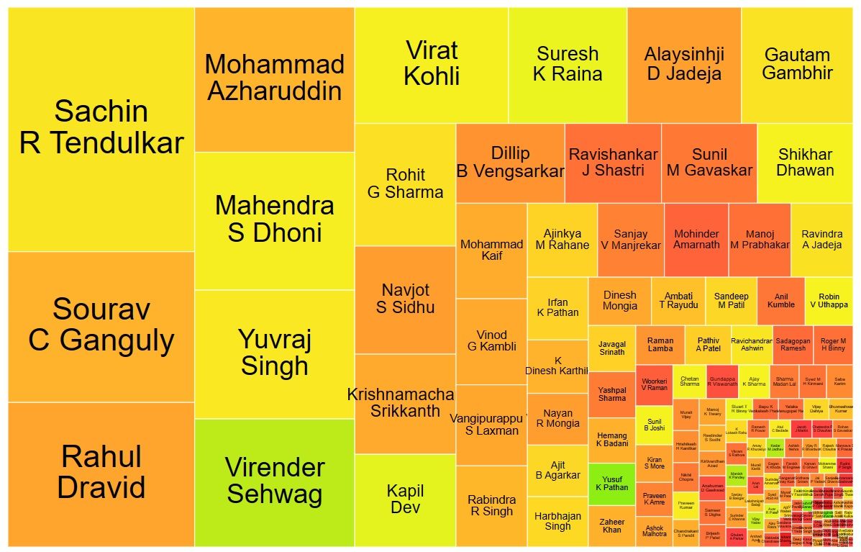
Visualisations - Some Examples:
ODI: Ind batting (gramener.com)

Slide 5
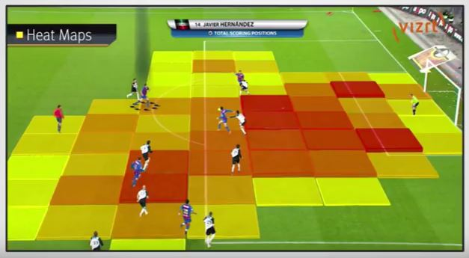
The Necessity of Data Visualisation
Anscombe's quartet – Wikipedia
“numerical calculations are exact, but graphs are rough.”

Slide 6
How do markets react to the budget?
India Budget History (gramener.com)

Slide 7
Software ecosystem
Software ecosystem (gramener.com)

Slide 8
Choosing Plot Types
Python code: 3_1 DataVIZ
PowerPoint Presentation (gramener.com)
The World’s Aging Population Crisis: Visualizing Demographic Transition | SocialCops
14 Best Types of Charts and Graphs for Data Visualization [+ Guide] (hubspot.com)
How to Choose the Right Data Visualization | Tutorial by Chartio

Slide 9
Web Scraping-I
The IMDB website provides movie-related information such as release date, runtime duration, cast, genre, ratings, etc. Now, consider a specific webpage on the IMDB website that lists the top-rated movies along with information about them. It lists the top 50 rated movies, the number of votes, etc. Now, what if you want to perform a deeper analysis to answer certain questions as follows?
Which director has the highest number of movies in the top 50 rated movies?
Which genre has the highest rating among the top 50 rated movies?
What is the gross expenditure of the lowest-rated movies as compared with the highest-rated ones?

Slide 10
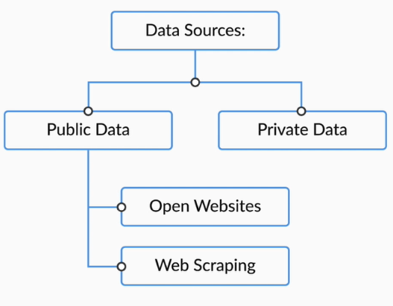
Given below are the links to some public datasets. You may explore these open sources to get the data:
GitHub: Awesome public data sets, Github data sets
Open government data set: Open Government data.
Kaggle website link: Kaggle Website
UCI repository of machine learning: UCI machine learning data set repository.

Slide 11
Pearson’s r value is a metric to measure the correlation between 2 numerical entities. You can read more about it in the following link
Scatter plots can show the trends for only 2 numeric variables. For understanding the relationships between 3 or more, you need to use other visualisations.

Slide 13
THANK YOU

